Slide 1
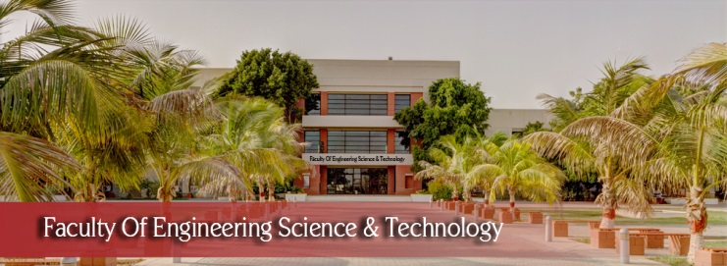

FYP
Project Name: A website for DOC, Hamdard University
Group members: Shahmeer Abid(2278-2021),
Syeda Noreen Zahra(2025-2021),
Hamza Sheikh(2595-2021)
Supervisor: Sir Afzal
Department of Computing, FEST
Hamdard University

Slide 2
Summary
Problem Statement
Objective
FYP Scope
Our methodology
Our Project Plan (Time lines)
Budget / Costing (if any)
FYP Deliverables
References
Item in red color are fundamental in any proposal

Slide 3
Problem Statement
There is no online website of Department of Computing
Manual processes for form submissions (Admission form, General Application form, FYP forms, etc), Queries of students and faculty, complaint handling, and announcements lead to delays.
The lack of a centralized platform for new students to access information about department, about timetables, any event occurring, which teacher is assigned to their classes .
By developing an Integrated website, the aim is to streamline these processes, improve accessibility to information, and enhance communication within the department.
Proposed project will address the need for a centralized system that allows for efficient management of departmental activities and better interaction between students and faculty.

Slide 4
Objective
To develop a dynamic and user friendly website for the Department Of Computing (DOC) Hamdard University.

Slide 5
FYP Scope
The scope of proposed project is to develop a dynamic and user friendly website for the department of computing. Following features will be included in website:
Home page
Sub Webpages for specific faculties
Complaint box
Detailed Departmental Information
Faculty Information
Events, News Announcement area
Integrated admission form, FYP form, General Application form
Section wise Timetable
Searching/Sorting
Chat bot
Library Book database

Slide 6
Our Methodology
Evolutionary prototype methodology is used for developing the Department of Computing website, by using this methodology, team will approach each functionality repeatedly, will make changes according to user feedback and improving overtime.

Slide 7
Literature Review
Features | University of Sindh, Jamshoro | IBA, Karachi | University of Lahore | KUST | Air University Pakistan | DOC FEST-HU
Home page |  |  |  |  |  | 
Sub-web pages of CS, SE, AI | ❒ |  | ❒ | ❒ | ❒ | 
Admission Form / General Application Form | ❒ |  | ❒ | ❒ | ❒ | 
Complaint box | ❒ | ❒ | ❒ | ❒ | ❒ | 
Timetable of every semester section wise | ❒ | ❒ | ❒ | ❒ | ❒ | 
Announcement area |  |  |  |  |  | 
HOD and Coordinator logins | ❒ | ❒ | ❒ | ❒ | ❒ | 
Information about department faculty, | ❒ |  |  |  |  | 
Library Information |  |  | ❒ | ❒ | ❒ | 

Slide 8
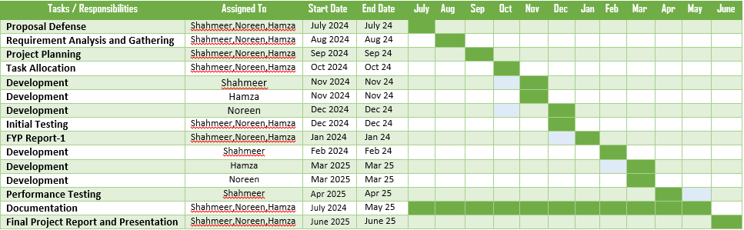
Our Project Plan

Slide 9
Budget / Costing
Components | Prices
2 laptops | 60,000 + 45000 = 1,05,000
Domain Hosting | 8000
Miscellaneous expenses | 8000
Printing of documents | 4000
Total | 1,25,000

Slide 10
FYP Deliverables
FYP-I Evaluation
FYP-II Evaluation
SRS Document
Requirement analysis and gathering
Project Plan and Task Allocation
Initial Prototype
Development Core functionalities (Home page, sub pages, Admission, general, FYP form, Complaint box, Login, Timetable)
Testing and Report
Documentation and Report - I
Advance feature Development (Searching sorting, Announcement area, Faculty information, library Information) and Chat bot
Database Management
Backend Development
Integration
Testing
Final Refinement
Project Completion and Report - II

Slide 11
Reference
Internet Web page: University Of Lahore. “Faculties and Departments”. Last seen: 30 June 2024.
URL: https://uol.edu.pk/faculties-dept/
Internet Web page: Kohat University of Science and Technology. “Institute of Computing”. Last visit: 30 June 2024.
URL: https://www.kust.edu.pk/kust/index.php/academics/faculties/faculty-of-physical-numerical- sciences/institute-of-computing
Internet Web page: Air University Islamabad. “Faculty of Computing and AI”. Last visit: 30 June 2024.
URL: https://www.au.edu.pk/Pages/Faculties/Computing_AI/fact_cs_dean_msg.aspx
Internet Web page: University of Sindh, Jamshoro. “Faculty of Engineering and Technology”. Last visit: 30 June 2024.
URL: https://usindh.edu.pk/
Internet Web page: IBA Karachi. “Undergraduate Programs”. Last visit: 30 June 2024.
URL: https://www.iba.edu.pk/undergraduate.php

